Slide 1
RECAP 24/25.02.2014
Systems & Realtime
Macros
Includes

Slide 2
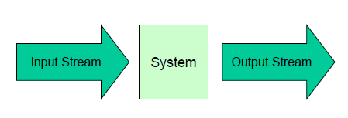
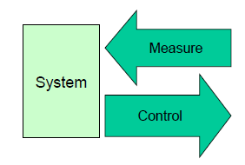
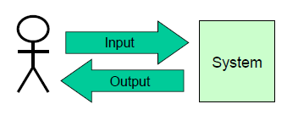
3 Embedded Systems
Transforming System
Throughput [Bytes/s]
Data processing quality
system utilization
Reactive System
ext. Events are driving system (closed loop control systems)
Guaranteed response time
Realtime
Interactive System
short response time
High system utilization
HMI

Slide 3
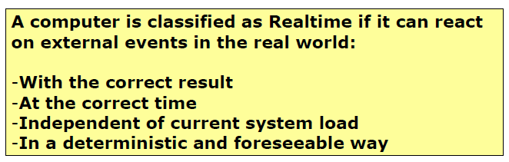
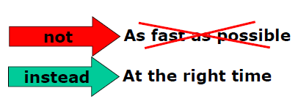
Realtime

Slide 4
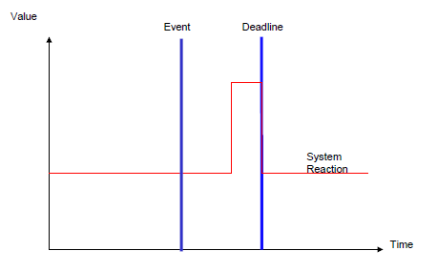
Hard Realtime (Airbag)
Incorrect if correct result does not meet with the time conditions

Slide 5
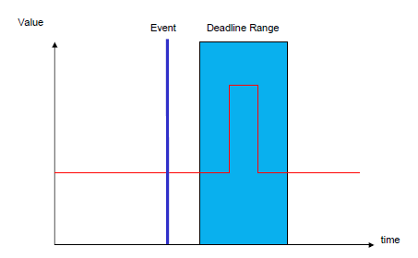
Soft Realtime (video encoder)
Degradation, if correct result does not meet the time conditions

Slide 6
Questions
Name each one example for a transfoming system, reactive system and interactive system?
TS: Video encoder, RS: PID Controller, IS: ticket selling machine

